Slide 1



🌱 Carbon Emission Prediction Using Machine Learning
Name : VANI SAI DEEPIKA
AICTE Internship ID : STU6641f91d5732e1715599645

Slide 2

Learning Objectives
During this internship, I aimed to:
Apply Exploratory Data Analysis (EDA) techniques on real-world CSV datasets.
Preprocess and clean datasets in a systematic manner
Build and tune a Random Forest Regression model for prediction
Evaluate model performance using RMSE, MSE & R² metrics
Improve the presentation of technical outputs for documentation and GitHub
GOAL
Source :
www.freepik.com/

Slide 3
Tools and Technology used
Language and Libraries: Python, Pandas, NumPy, Matplotlib, Seaborn, Missing no, Scikit-learn
Machine Learning Algorithm: Random Forest Regressor
Notebook Environment: Jupyter Notebook, Google Colab
Development Tools: Visual Studio Code (VS Code), GitHub

Slide 4
Methodology
The project followed a structured, three-week workflow to build a predictive machine learning model for carbon emissions, with each phase focused on preparing the data, extracting insights, building models, and evaluating performance.
🔁 Process Flow :
Data Cleaning – Removed nulls, handled duplicates
EDA – Correlation & trend analysis
Feature Engineering – Selected top influencing variables
Model Building – Random Forest Regression
Evaluation – RMSE, MSE & R² Score
Prediction – Forecasted CO₂ emissions

Slide 5
Methodology
🗓️ Weekly Breakdown:
📅 Week 1 – Data Preparation: Cleaned raw data, handled missing values, and saved as data_cleaned.csv.
📅 Week 2 – EDA & Feature Engineering: Visualized trends, correlations, and selected influential numerical features.
📅 Week 3 – Model Building & Evaluation: Built a Random Forest Regressor, evaluated model accuracy, and performed cross-validation.
Step 1: Data Preparation (Week 1) :
In this project, I first downloaded the raw climate change dataset, inspected it for missing/inconsistent values using pandas and missingno, and performed systematic cleaning operations. I then saved the cleaned dataset as data_cleaned.csv for downstream analysis.
✅ Logged and versioned on GitHub for reproducibility.
🔗 📁 WEEK 1

Slide 6
Methodology
Step 2: EDA & Feature Engineering (Week 2) :
I loaded the cleaned dataset, performed Exploratory Data Analysis using Seaborn and Matplotlib, visualized distributions, and analyzed feature correlations to identify important variables. I prepared the numerical features for model ingestion.
✅ Logged and versioned on GitHub for reproducibility.
🔗 📁 WEEK 2
Step 3: Model Building & Evaluation (Week 3)
I applied a train-test split on the prepared data, implemented a Random Forest Regressor to predict carbon emissions, and evaluated the model using R², RMSE, and MAE for accuracy. I visualized Prediction vs Actual outputs and performed cross-validation to ensure robustness.
✅ Logged and versioned on GitHub for reproducibility.
🔗 📁 WEEK 3
Each step was logged, versioned, and uploaded to GitHub for transparency, structured learning, and reproducibility.

Slide 7
Problem Statement:
High levels of carbon emissions from vehicles are a major contributor to environmental pollution and global climate change. These emissions degrade air quality, affect public health, and contribute to the accumulation of greenhouse gases in the atmosphere, leading to global warming and ecological imbalance.
Predicting vehicle carbon emissions using machine learning models based on features such as engine size, fuel type, and vehicle weight enables a data-driven approach to understanding emission patterns. This empowers policymakers to draft effective environmental regulations, supports automobile manufacturers in designing low-emission vehicles, and helps environmental agencies monitor and manage emission levels proactively. By leveraging predictive analytics, stakeholders can prioritize emission control measures, promote sustainable mobility initiatives, and work towards achieving national and global carbon neutrality goals. Such data-driven interventions can significantly contribute to reducing the carbon footprint of the transportation sector, ensuring a cleaner, healthier, and more sustainable future for society.

Slide 8
Solution:
To address the challenge of vehicle carbon emissions, a Random Forest Regression model was developed to predict CO₂ emissions using key vehicle attributes such as engine size, fuel type, and vehicle weight. Leveraging machine learning enabled accurate, data-driven emission quantification, allowing stakeholders to identify influential factors and support emission-reduction strategies effectively.
The solution involved systematic steps, beginning with comprehensive Exploratory Data Analysis (EDA) to understand data distributions, identify outliers, and select impactful features for modeling. The dataset was split into training and testing subsets, and cross-validation techniques were applied to ensure the robustness and generalizability of the model. The Random Forest Regression model was evaluated using the following performance metrics to measure prediction accuracy and reliability:
Coefficient of Determination (R²)
Mean Squared Error (MSE)
Root Mean Squared Error (RMSE)
This structured, practical workflow not only facilitated effective model training but also ensured that the outputs could be presented clearly for documentation and GitHub deployment, enhancing transparency and reproducibility for real-world applications.

Slide 9
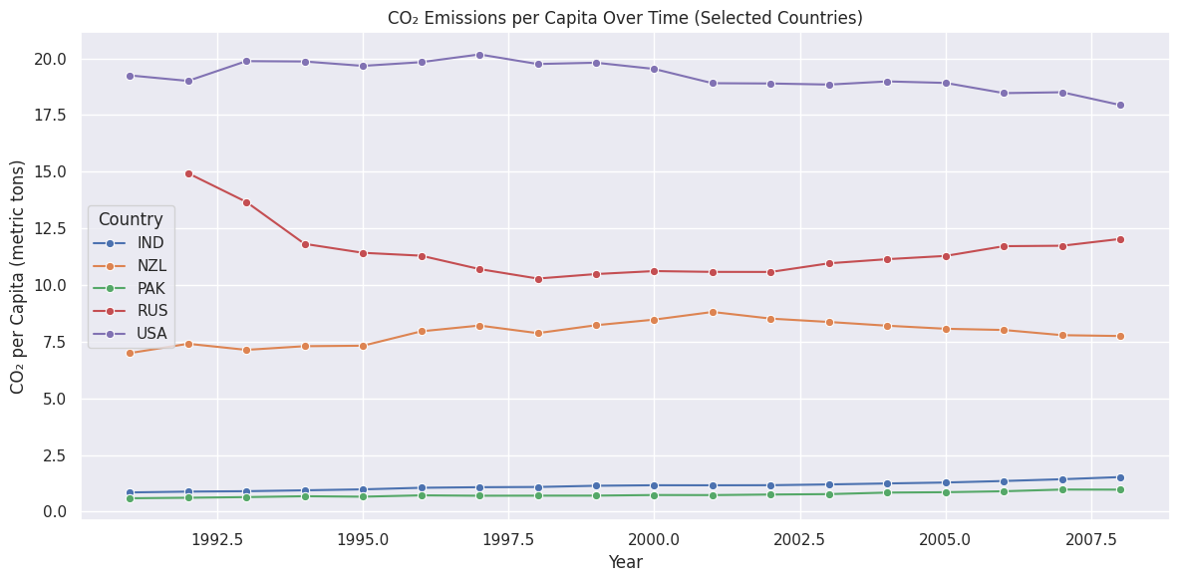
Screenshot of Output:
📊 CO₂ Emissions per Capita Over Time (Selected Countries) : A line plot comparing CO₂ emissions per capita over time (1990–2008) for five countries: India (IND), New Zealand (NZL), Pakistan (PAK), Russia (RUS), and the USA.
📌 Key observations:
The USA maintains the highest CO₂ per capita, followed by Russia.
India and Pakistan exhibit a gradual increase over the years.
New Zealand shows moderate emissions with minor fluctuations.
Russia shows a declining trend initially, then stabilizes.
📌 This visualization helps in understanding emission trends across countries with differentdevelopment levels and highlights the significance of focusing on both high and low per-capita emittersfor climate policy design.

Slide 10
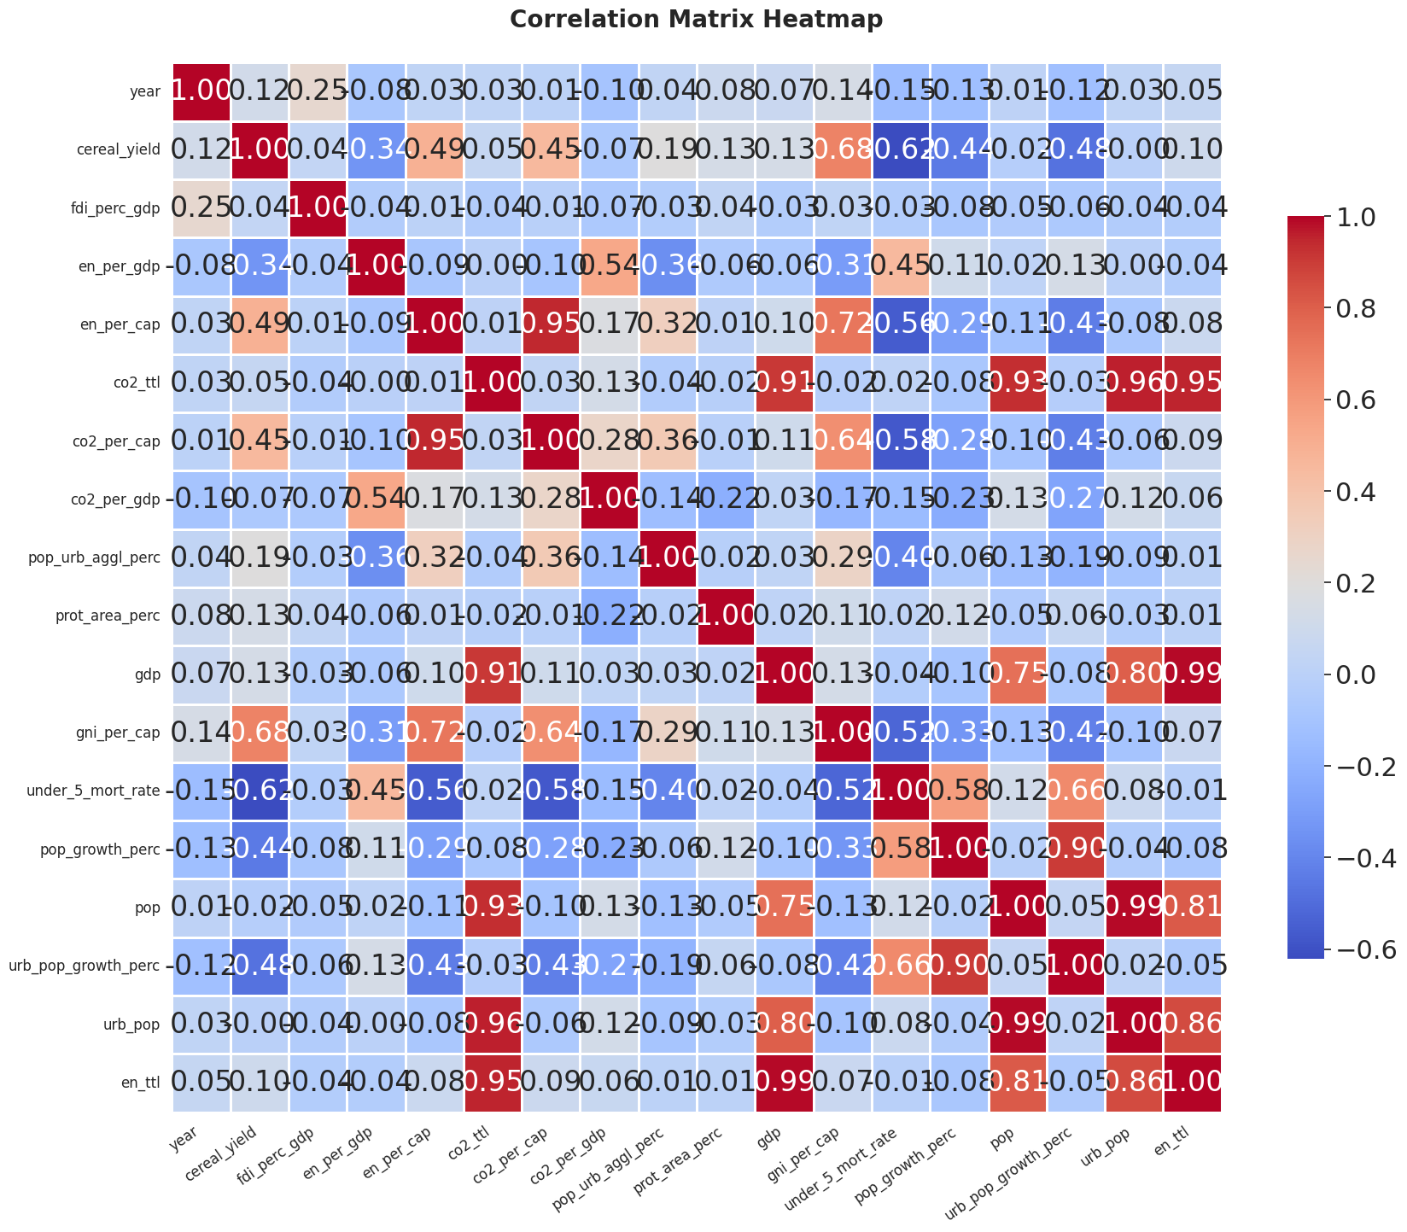
Screenshot of Output:
📊 Correlation Matrix Heatmap
A visual representation of the pairwise correlations between numerical variables in the dataset. The heatmap helps identify how features like energy use, GDP, CO₂ emissions, and population metrics are related.
📌 Key Observations:
High positive correlation observed between energy consumption and total CO₂ emissions, indicating that higher energy use contributes significantly to emission levels.
CO₂ emissions per capita positively correlate with GDP per capita, suggesting economic activity influences individual carbon footprints.
Negative correlation found between GDP growth and CO₂ emissions per unit of GDP, possibly reflecting energy efficiency improvements in developing economies.
📌 This plot plays a crucial role in feature selection for the Random Forest Regressor by:
Highlighting highly correlated predictors with the target (CO₂ emissions)
Helping you avoid multicollinearity, which can reduce model generalization
Informing dimensionality reduction or engineering steps before model training

Slide 11
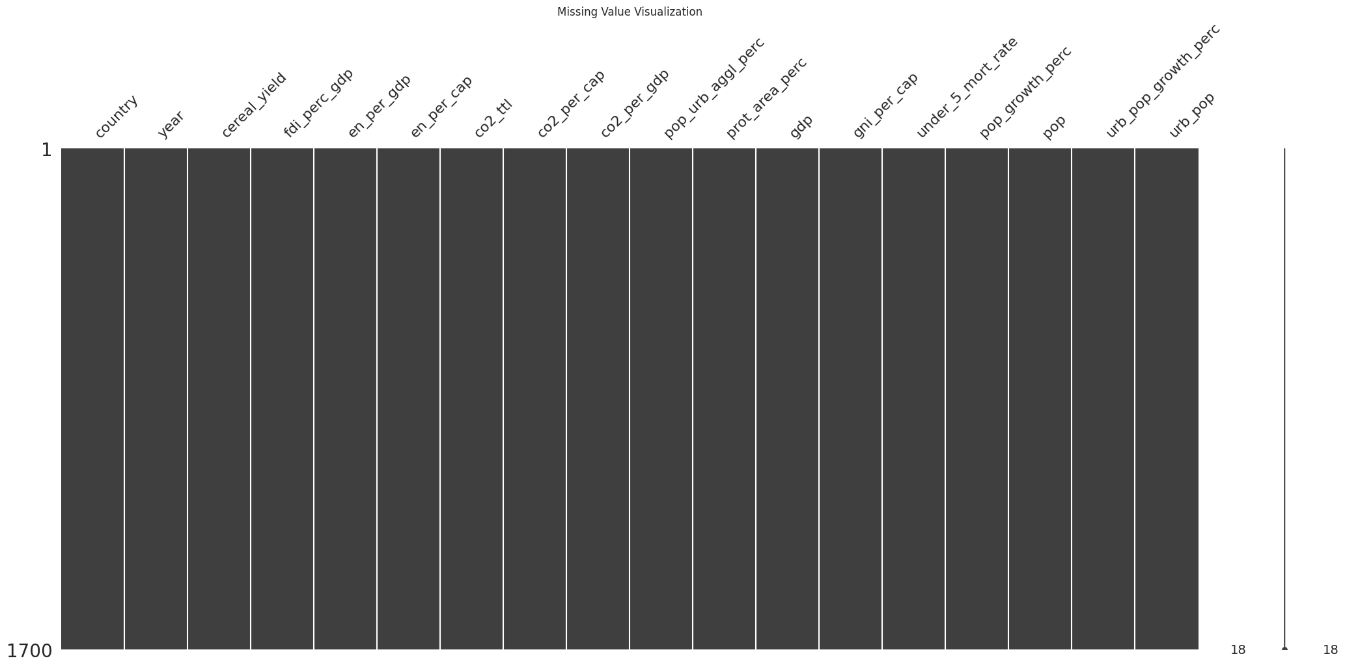
Screenshot of Output: ​
📊 Missing Value Visualization
A bar chart was used to display the amount of missing or null values in each feature of the dataset. This visualization was created using the missingno Python library as part of the initial Exploratory Data Analysis (EDA) phase.
📌 Key Observations from the Graph:
Certain columns such as energy_use and population_growth showed significant missing values.
Some features exhibited random missingness, while others displayed structured or patterned gaps.
Features with excessive missing data were considered for removal or imputation.
Imputation techniques like mean, median, or interpolation were applied where appropriate.
This step helped improve the model's robustness and reduced the risk of biased predictions due to incomplete data.

Slide 12
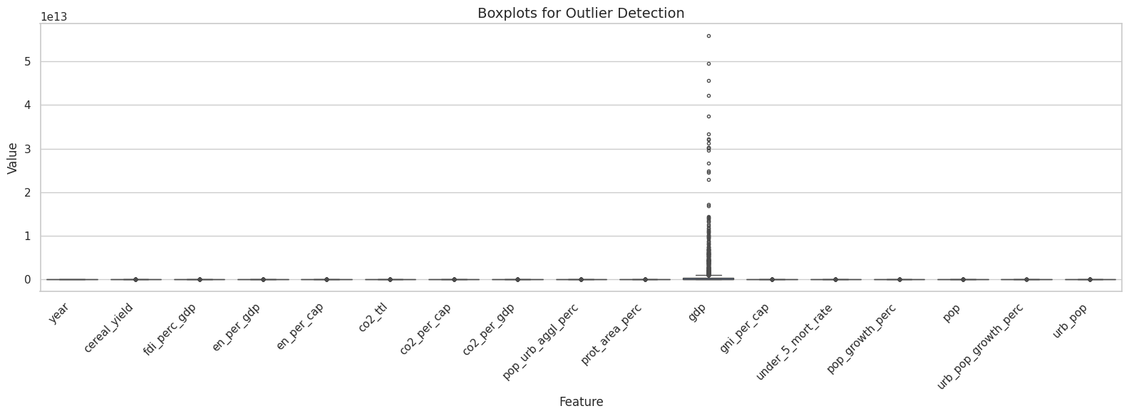
Screenshot of Output: ​
📦 Outlier Detection Using Boxplots: Boxplots were used to visually detect outliers in key numerical features of the dataset such as CO₂ emissions, fuel consumption, energy use, and engine size.
These plots helped identify extreme values that could skew the model, inflate errors, or mislead feature importance.
📌Key Observations from the Boxplots:
CO₂ emissions & fuel consumption showed upper outliers → high-polluting vehicles.
Energy use per capita had a long upper tail → industrialized nations.
GDP growth rate had negative outliers → recession-impacted regions.

Slide 13
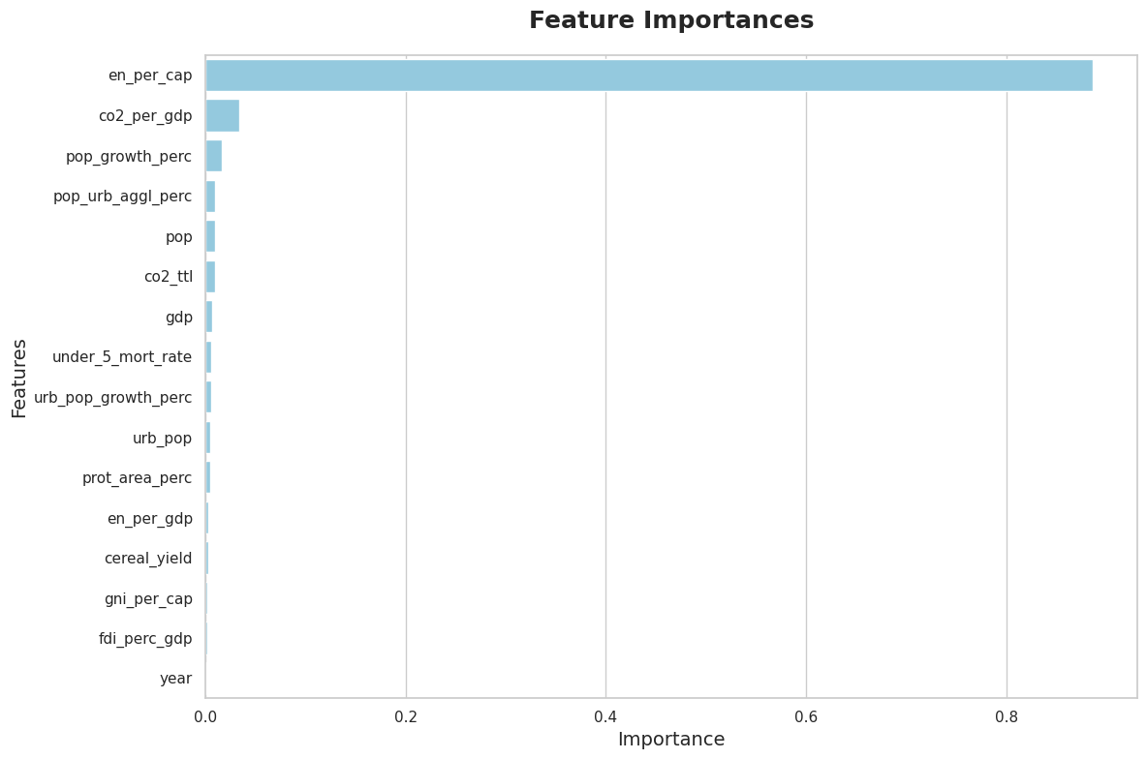
Screenshot of Output: ​
Feature Importance:
The Feature Importance plot highlights the most influential variables in predicting CO₂ emissions, as determined by the Random Forest Regressor. This plot is generated using the .feature_importances_ attribute from the trained model.
📌 Key Observations from the Graph:
Engine Size and Fuel Consumption emerged as the top predictors of carbon emissions.
Features like GDP per capita and energy use per capita showed moderate influence.
Variables with low importance (e.g., population growth, GDP growth rate) contributed minimally and can be considered for feature reduction in future models.

Slide 14
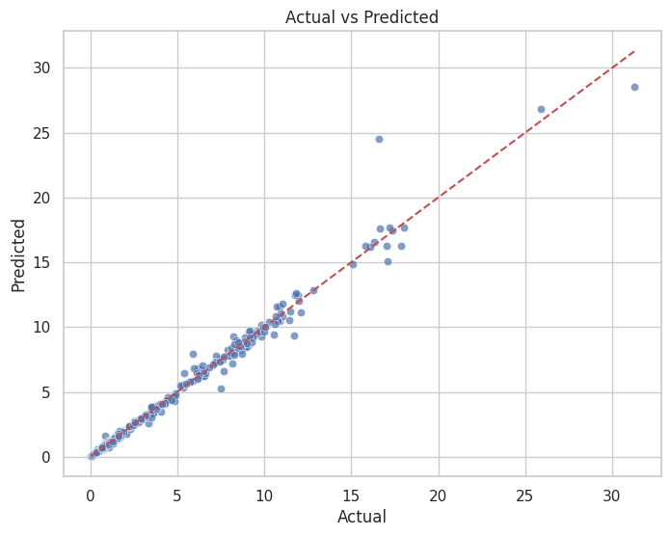
Screenshot of Output: ​
📊Model Prediction vs Actual Plot
A scatter plot comparing predicted CO₂ emission values against the actual values.
📌 Key observations:
Points closely aligned along the diagonal line indicate high prediction accuracy.
Slight deviations reveal areas where the model may underpredict or overpredict.
📌This plot provides visual evidence of your model’s performance, allowing stakeholders to trust the model’s predictions for practical use.

Slide 15
Conclusion:
This internship project successfully demonstrated the complete development of a data-driven pipeline, covering each critical stage from systematic data cleaning and thorough exploratory data analysis (EDA) to insightful feature engineering, robust model building, and comprehensive performance evaluation. By handling real-world, imperfect datasets, this experience strengthened my ability to tackle practical data challenges with confidence and precision.
Through the implementation of the Random Forest Regression algorithm, I developed a deeper understanding of its effectiveness for prediction tasks involving complex relationships and multiple features. This project also enhanced my skills in interpreting model results and communicating technical findings clearly. The outcomes and workflow established here provide a strong foundation for integrating similar predictive models into larger machine learning pipelines aimed at supporting environmental sustainability initiatives and informed policy-making. This learning journey has equipped me to contribute to future data-driven projects with a focus on impactful, real-world applications.

